Slide 1
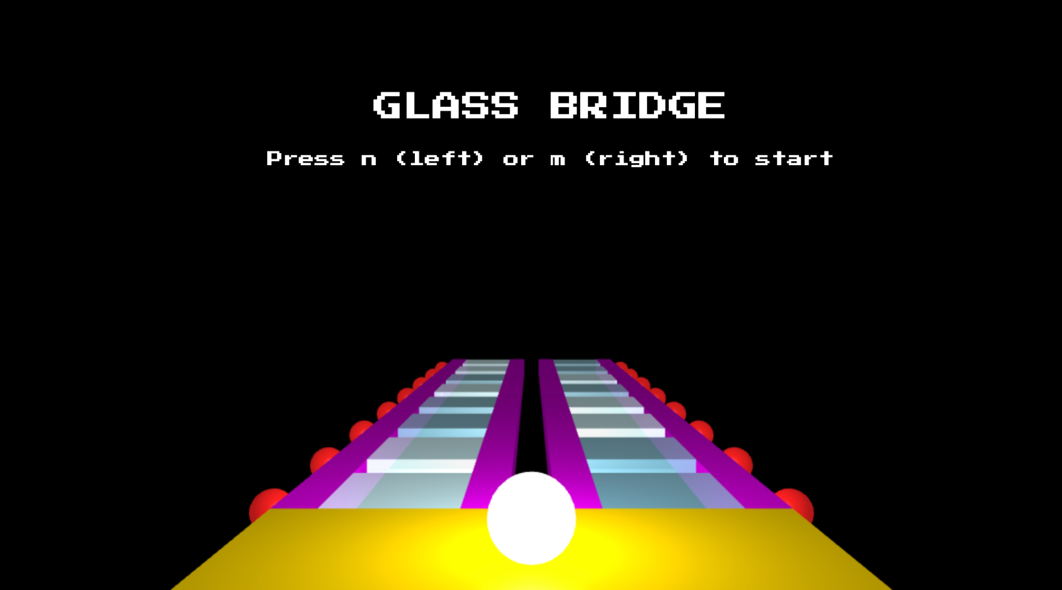
shdgcvjksdnlmaskldfnlksmdfjhbehakfuhgdjbsjbfjaherfeiruhgiutghu
Carlie Huang, Danny Lee, Tony Li, Nicholas Tucker

Slide 2
Physics Based Jump

Slide 3
Shatter Effect + Fall + Regenerate

Slide 4
Checkpoints every 10 steps

Slide 5
60 seconds (or 0 lives) to Game Over

Slide 6
LIVE hello
LIVE DEMO
shdgcvjksdnlmaskldfnlksmdfjhbehakfuhgdjbsjbfjaherfeiruhgiutghu
Let’s see it in action!

